Slide 1
Facts ABOUt the blitz ww2
1940-1941

Slide 2
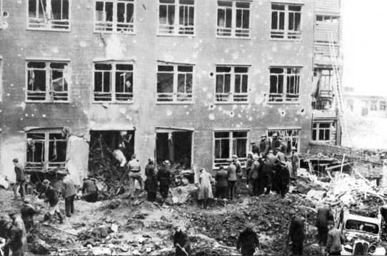
During the Blitz 7,736 children were killed and 7,622 seriously wounded. Many children were orphaned or lost brothers and sisters. As well as being victims of the raids, children were involved in relief efforts.

Slide 3
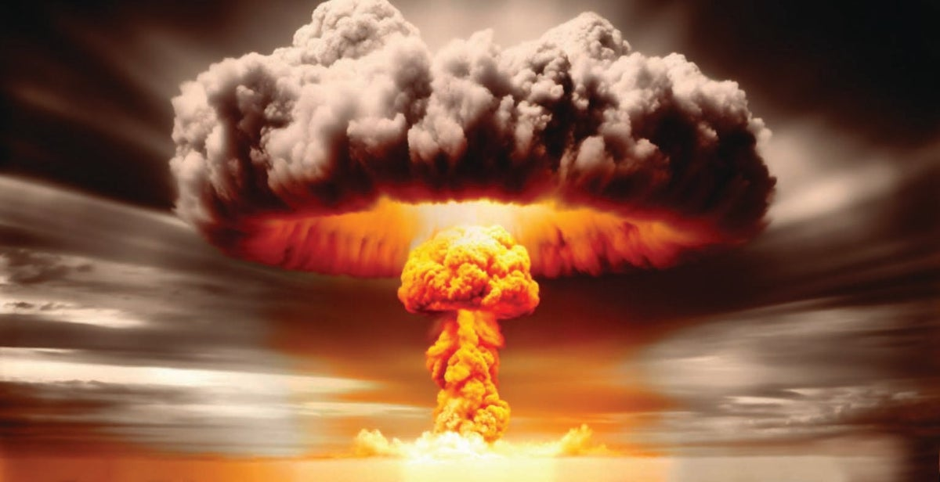
It is estimated that more than 12,000 metric tons of bombs were dropped on London and nearly 30,000 civilians were killed by enemy action.

Slide 4
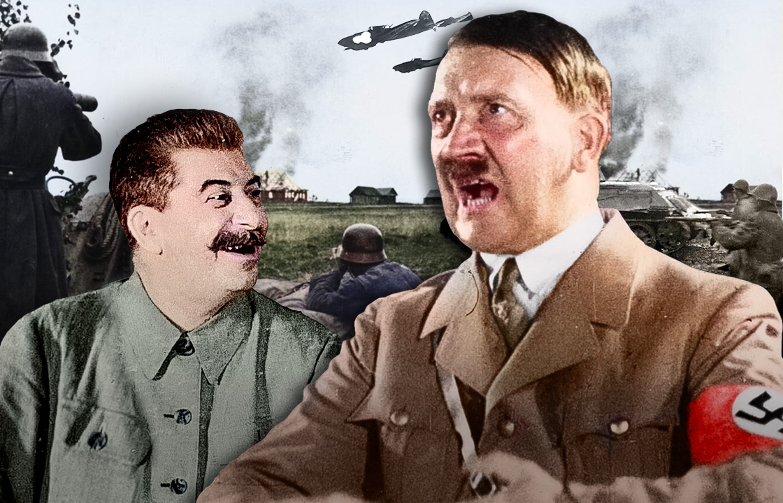
The Blitz was a German bombing campaign against the United Kingdom, from 7 September 1940 to 11 May 1941, for a little more than 8 months during the Second World War.

Slide 5
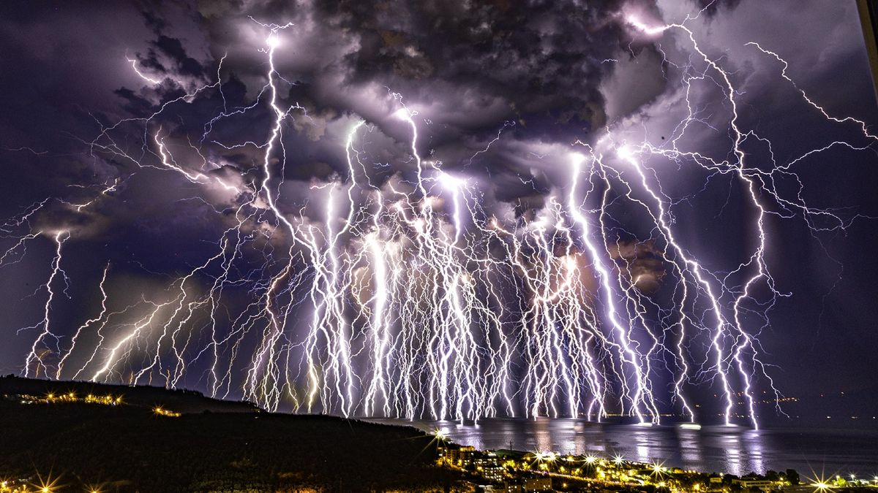
Blitz' is an abbreviation of the German word 'blitzkrieg', meaning 'lightning war'. Its explosive sound describes the Luftwaffe's almost continual aerial bombardment of the British Isles from September 1940 to May 1941

Slide 6
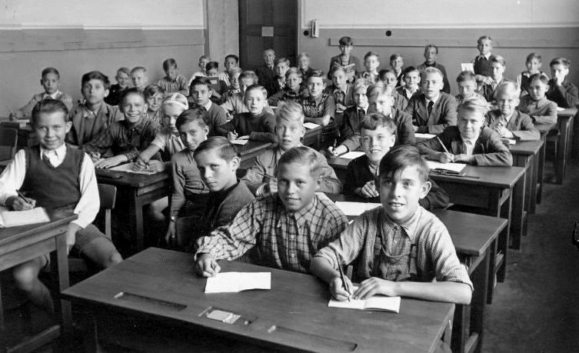
The Blitz impacted on all classes in London, but working class East London and the areas around the docks both north and south of the river suffered particularly badly. Death, disruption, destruction and evacuation were experienced more acutely by the working classes than by other sections of London's population.

Slide 7
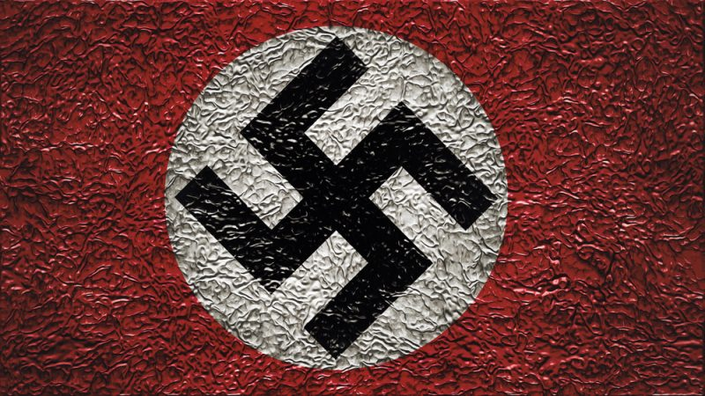
The Blitz was the sustained bombing of the United Kingdom by Nazi Germany between 7 September 1940 and 16 May 1941. It was carried out by the Luftwaffe, and hit many towns and cities across the UK, but the main attack was concentrated on London.

Slide 8
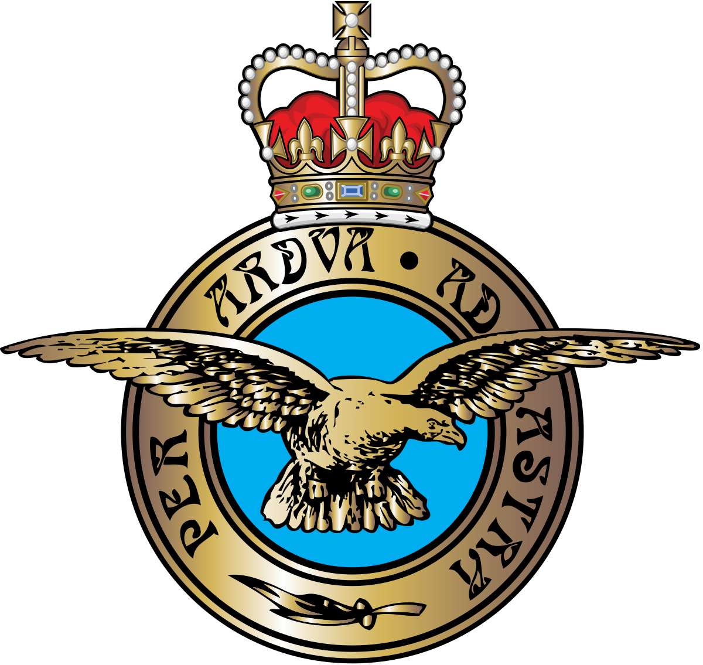
The end of the Blitz The Blitz ended on 11th May 1941. The RAF had won the Battle of Britain, and the invasion of the country was postponed by Germany. While the raids outlined above were some of the most infamous during the campaign, many other areas of the country were also hit

Slide 9
But the repeated heavy raids would not crush the morale of the British people. The 'Blitz' spirit kept them going. And Churchill played his part in keeping up morale. He made sure he was frequently in the public eye, constantly travelling around the country, visiting ammunition factories, shipyards, the troops.

Slide 10
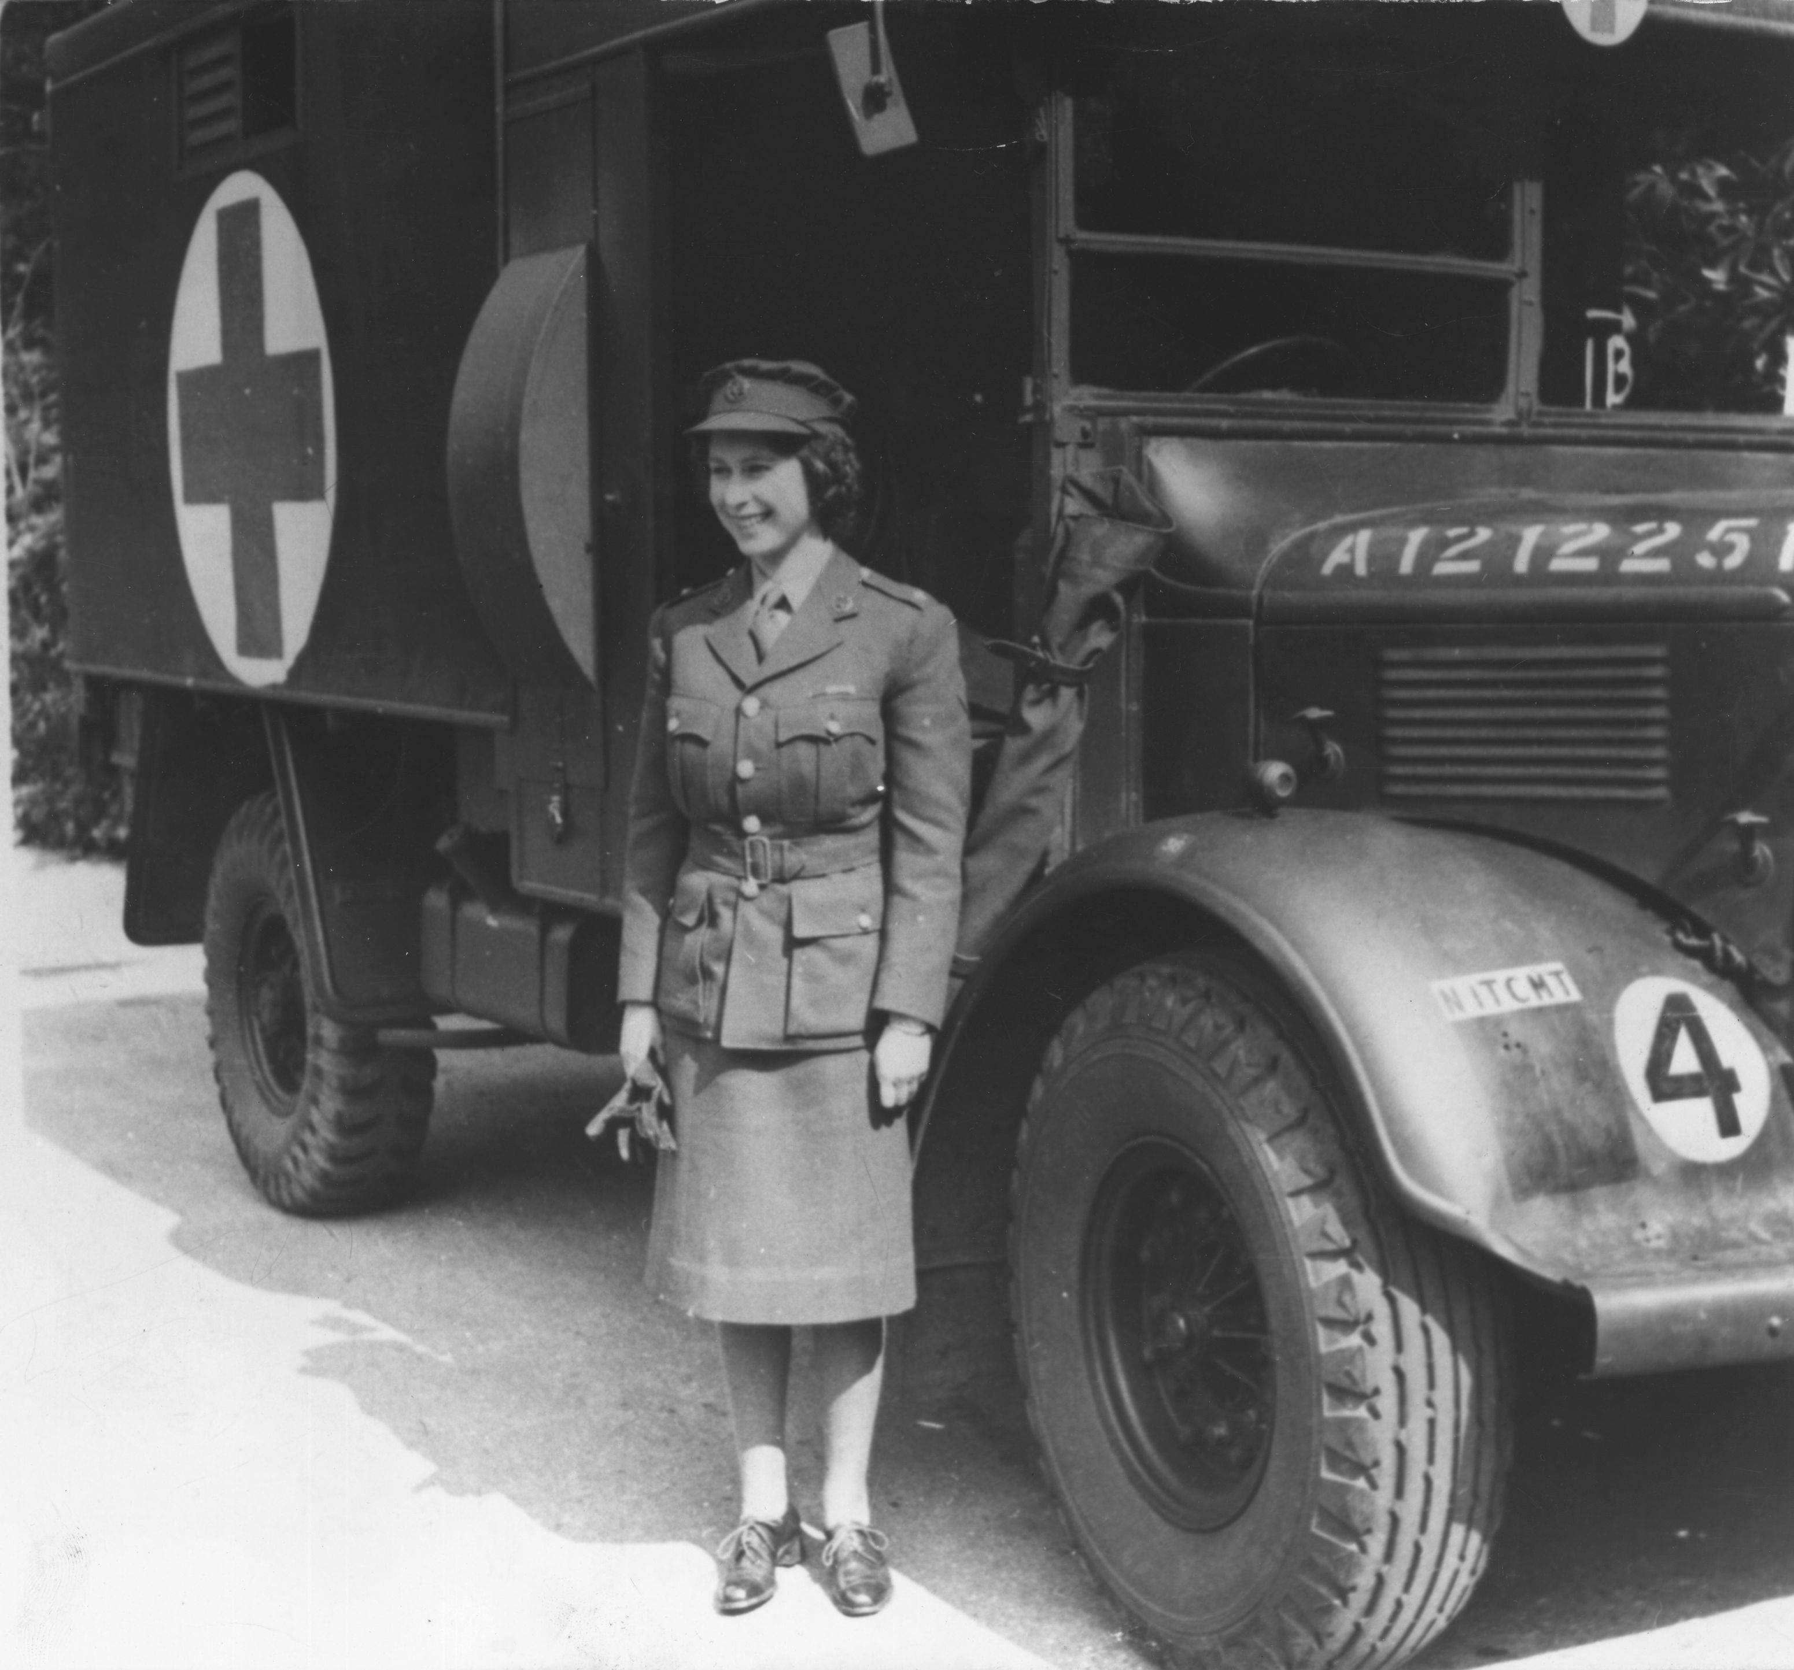
During the Second World War the heir to the throne, Princess Elizabeth, served in the Auxiliary Territorial Service (ATS). This made her the first woman in the Royal Family to become a full-time member of the armed services. Here are 12 photographs showing the enduring links between The Royal Family and wartime.

Slide 11
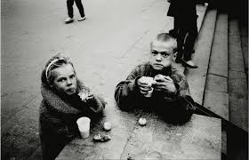
The Blitz, the German bombing campaign against Britain during the Second World War, had a profound impact on London. From September 1940, the German Luftwaffe dropped some 20,000 bombs on the city, killing thousands, and leaving many more homeless.

Slide 12
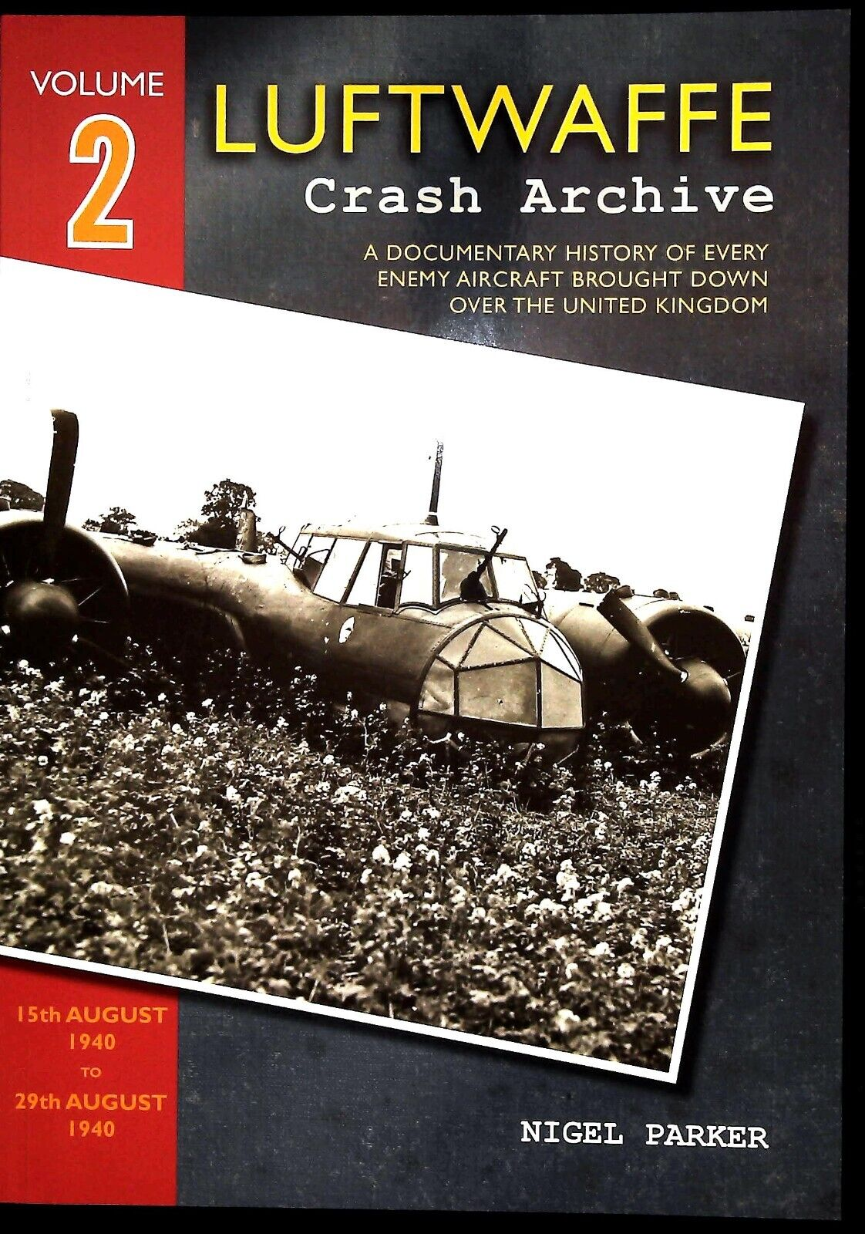
It was supposed Bomber Command, Coastal Command, and the Royal Navy could not operate under conditions of German air superiority. The Luftwaffe's poor intelligence meant that their aircraft were not always able to locate their targets, and thus attacks on factories and airfields failed to achieve the desired results

Slide 13
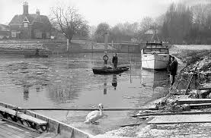
The most devastating raid on London took place on the night of 10/11 May 1941. The moon was full and the Thames had a very low ebb tide. These two combined with a maximum effort by the Germans, before the moved east to attack the Soviet Union, to produce one of the most devastating raids on the capital.

Slide 14
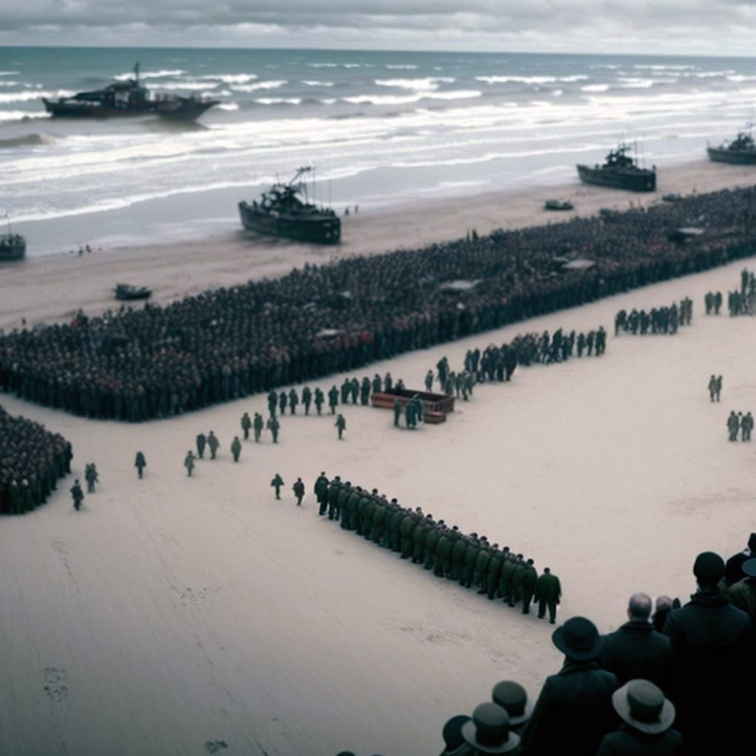
It is on May 24 that the mysterious “Halt Order” is issued by the Germans. Instead of destroying the forces trapped at Dunkirk, the Germans halt the advance of tank divisions for three days, during which time the Luftwaffe continues to attack, battling against the RAF.

Slide 15
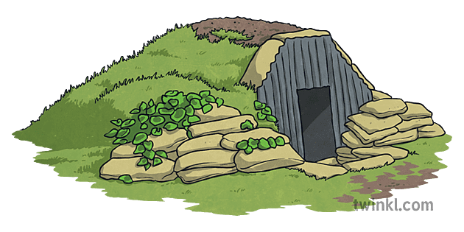
Air raids often required sleeping in uncomfortable air raid shelters. Hundreds of thousands of people had their homes destroyed and lost loved ones. The homeless depended on government and charity rescue centres for food and clothing.

Slide 16
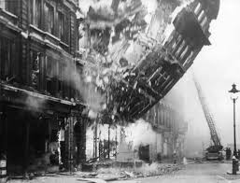
20,000. More than 20,000 bombs fell on London, destroying or damaging beyond repair 116,000 buildings. Bombing raids also left 100,000 people homeless in Belfast and 35,000 homeless in the town of Clydebank. During a three-night blitz on Swansea more than 11,000 buildings and homes were destroyed or damaged.

Slide 17
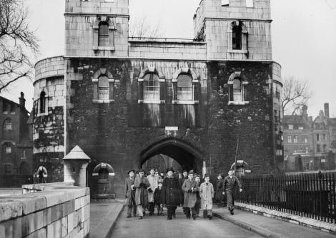
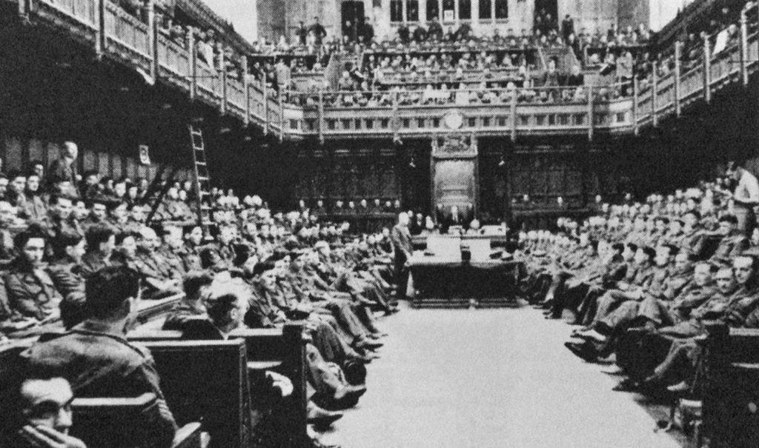
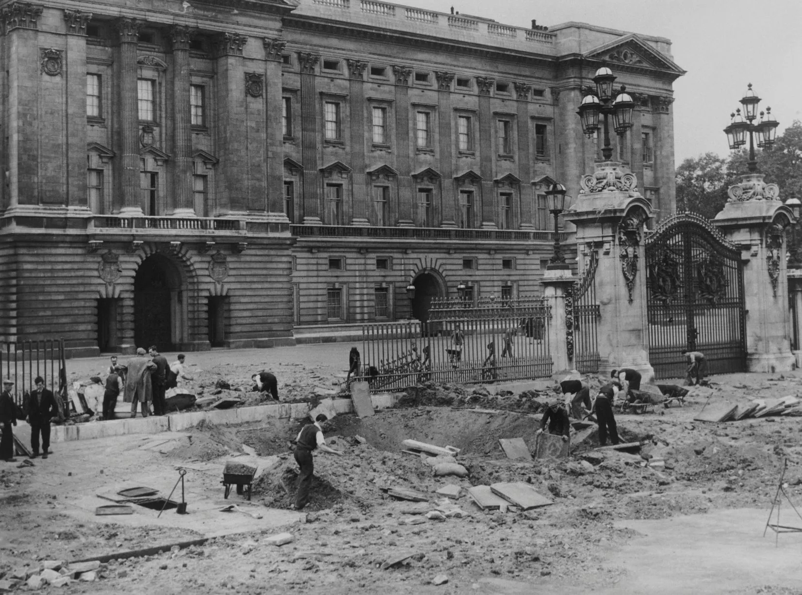
The Blitz changed the landscape of the city. Many famous landmarks were hit, including Buckingham Palace, the Houses of Parliament, the Tower of London and the Imperial War Museum. Some areas, such as Stepney, were so badly damaged that they had to be almost entirely rebuilt after the war.

Slide 18
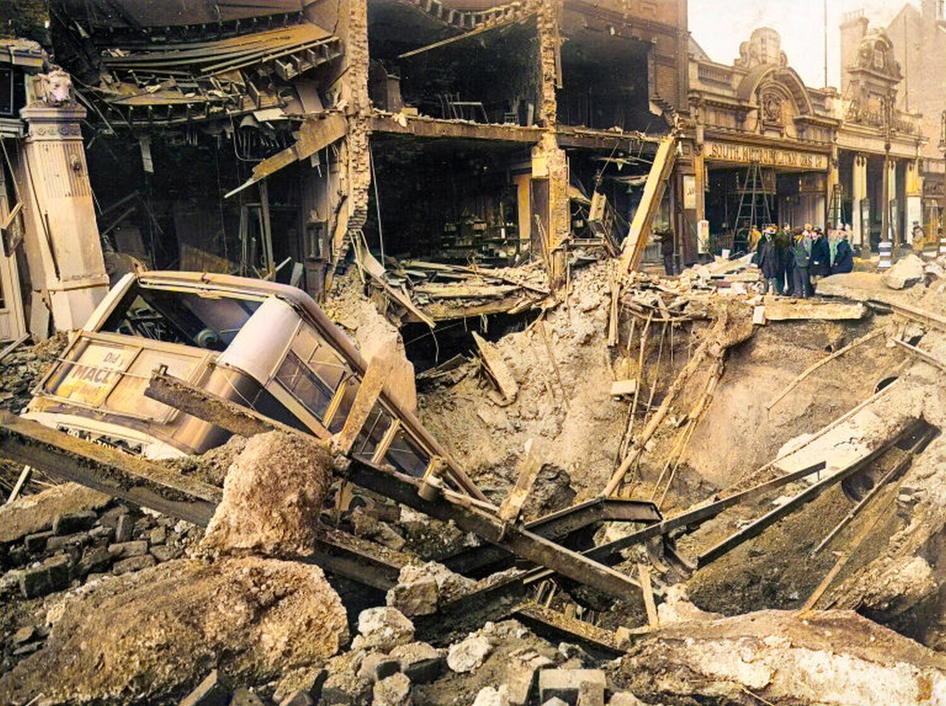
The Blitz is important because it was one of the most horrific bombing campaigns of World War II. It brought British citizens together and strengthened the nation's resolve to carry on the war more or less alone for over a year.

Slide 19
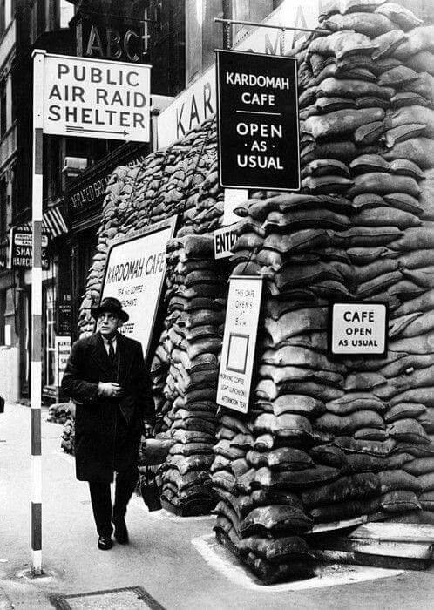
The Blitz began on 7 September, 'Black Saturday', when German bombers attacked London, leaving 430 dead and 1,600 injured. London was then bombed for 57 consecutive nights, and often during daytime too. London experienced regular attacks and on 10-11 May 1941 was hit by its biggest raid.

Slide 20
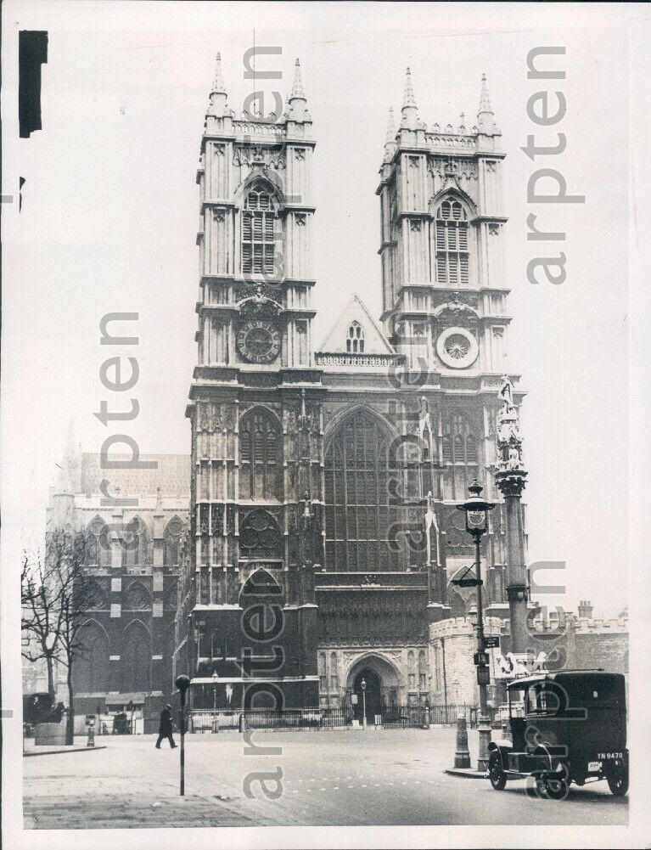
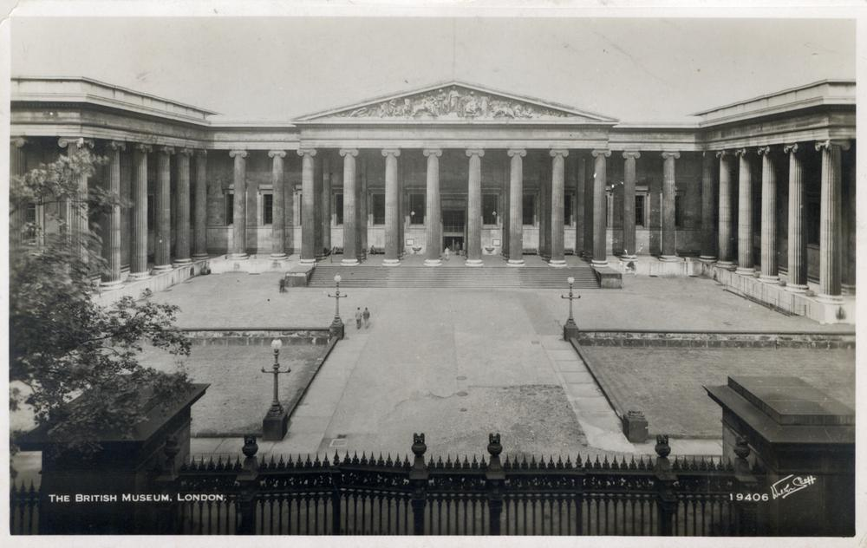
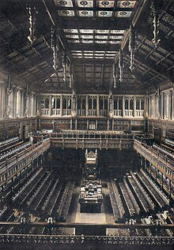
More than 500 German planes dropped more than 700 tons of bombs across the city, killing nearly 1,500 people and destroying 11,000 homes. The House of Commons, Westminster Abbey, and the British Museum were severely damaged, and The Temple was almost completely destroyed.

Slide 21
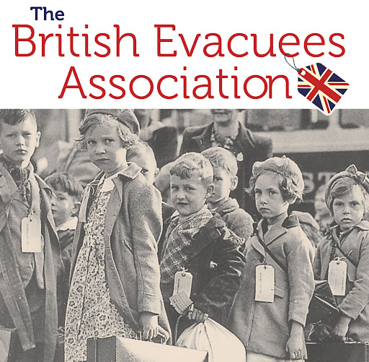
Within the next three days, 1.5 million evacuees were sent from cities and towns into rural areas considered safe, and over the course of the war around 4 million people left their homes. It was a huge logistical exercise that required tens of thousands of volunteer helpers.

Slide 22
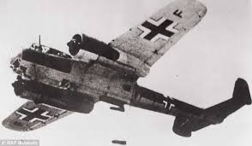
The government's voluntary evacuation scheme saw millions of children in Britain sent to places of safety for fear of German bombing. Many families made their own arrangements to evacuate their children to friends and family in the country or overseas.

